Slide 1

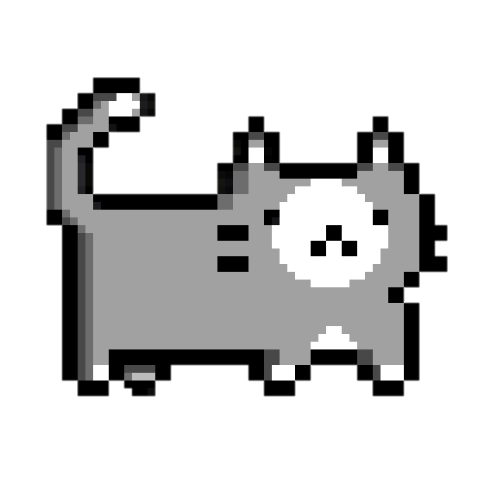

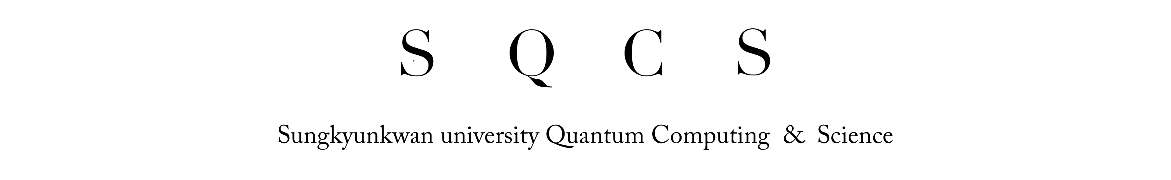

Slide 2
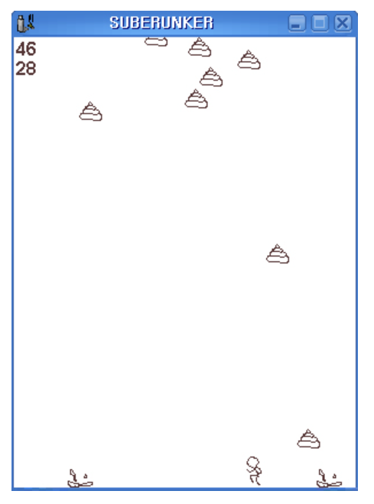
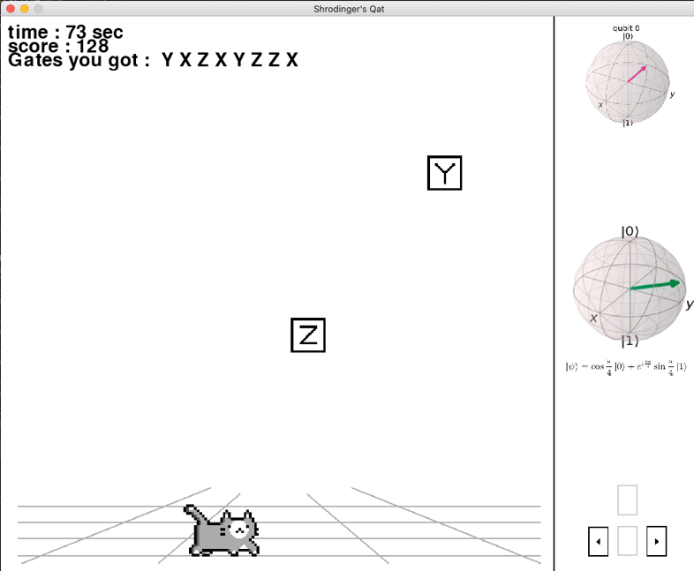
1. Introduction
Inspiration
“ Quantization of SUBERUNKER ”
Simple Classics games
“Avoid my poop!”
Simple Quantum games
“Get proper Q-gates!”

Slide 3
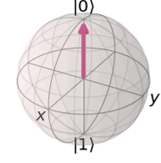
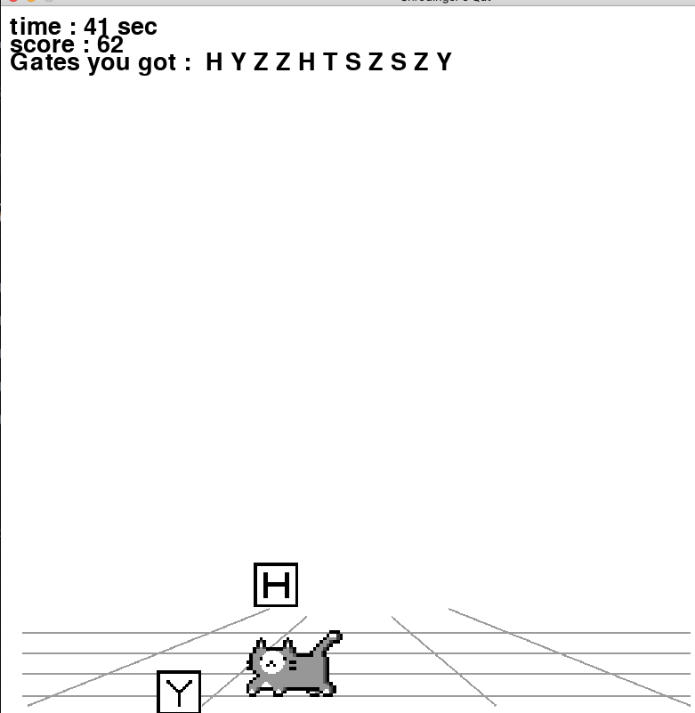
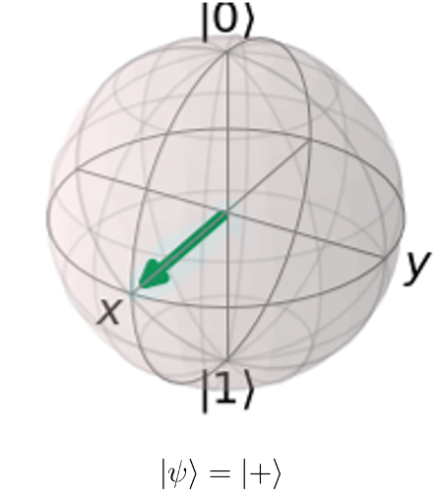
2. Main Idea / How to play
How to play
“Get proper Q gates to make target states”
“ Present states ”
“ Target states ”

Slide 4
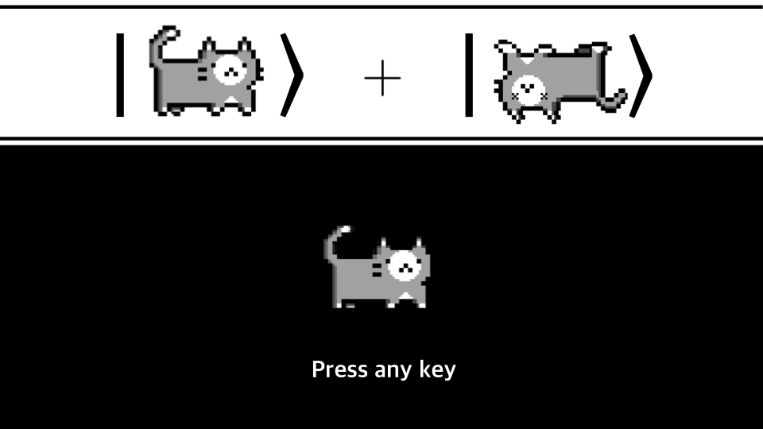
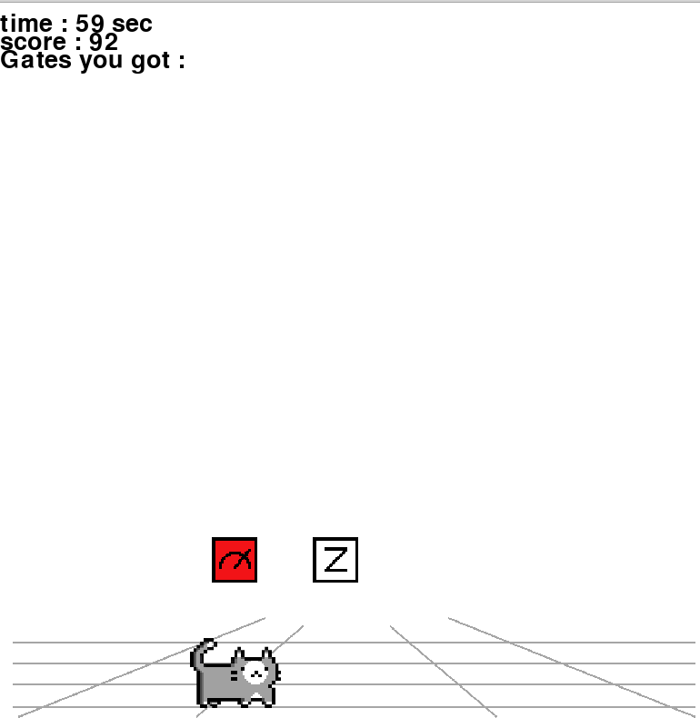
2. Main Idea / How to play
How to play
“To 0 or not To 0 that is the problem”
“Superposed”

Slide 5
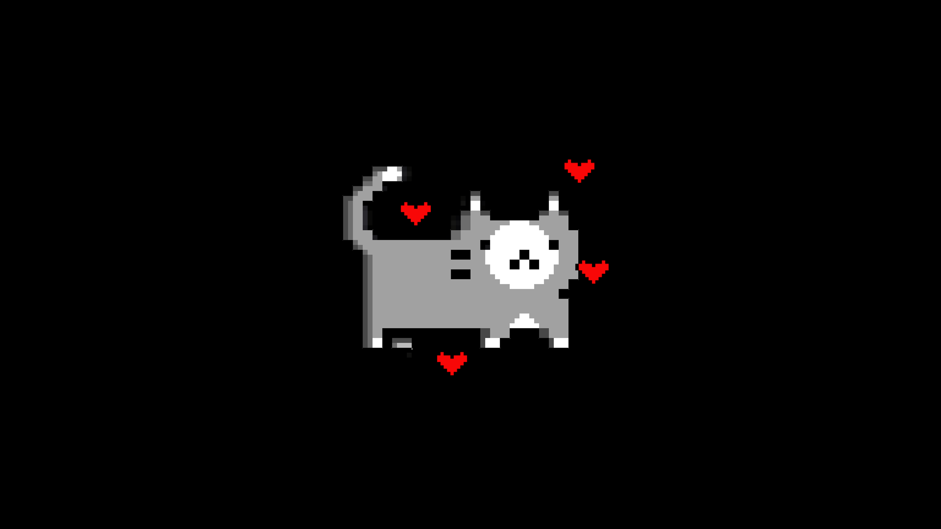
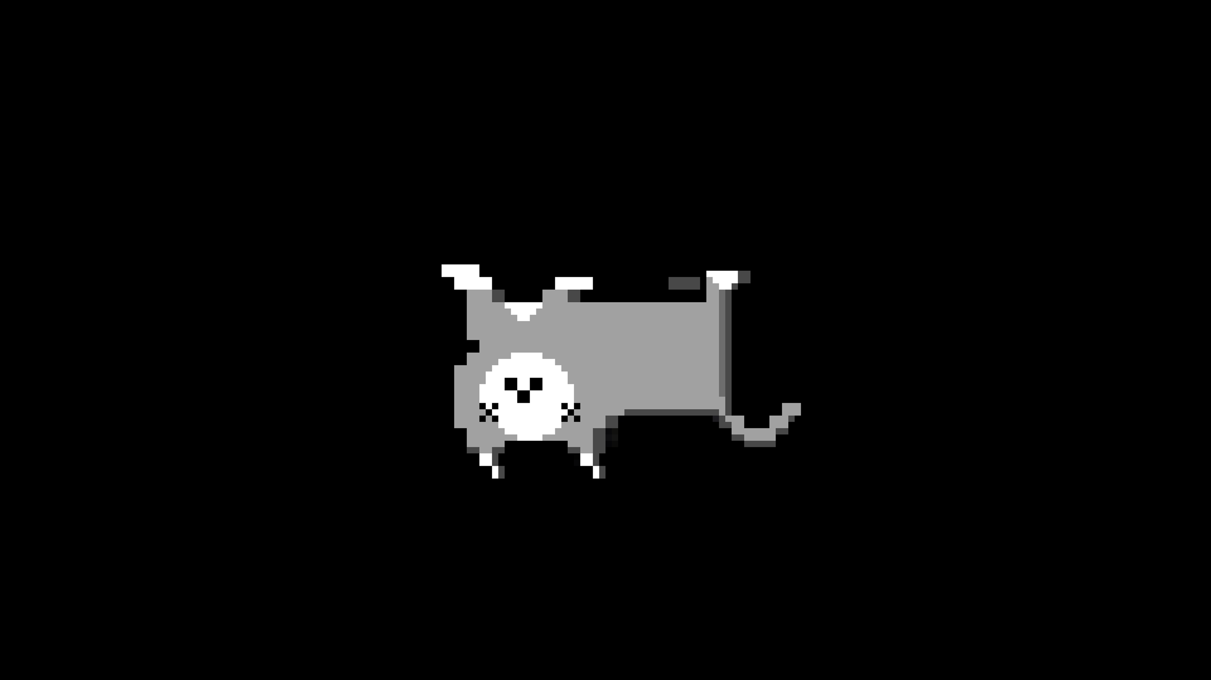
2. Main Idea / How to play
How to play
“To 0 or not To 0 that is the problem”
“Collapsed to one of the states”

Slide 6
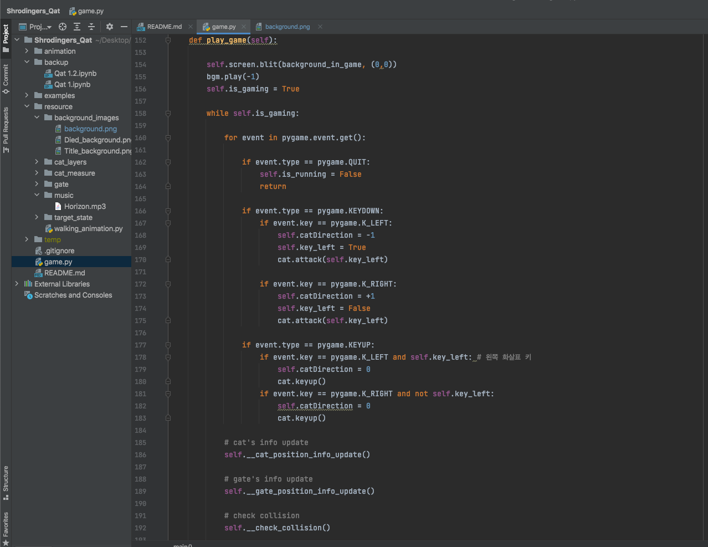
2. Main Idea / Materialization
Materialzation
“pygame”

Slide 7
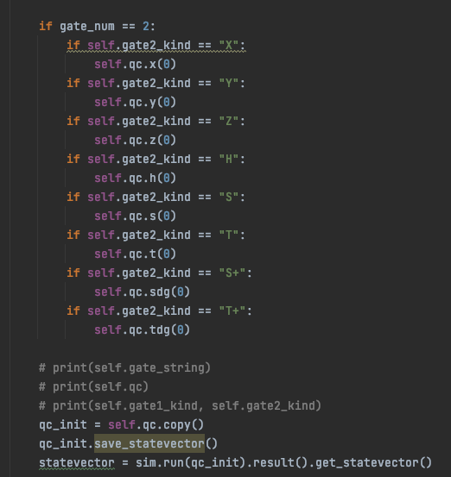
2. Main Idea / Materialization
Materialzation
“Qiskit”

Slide 8
Thanks

